Slide 1
bit.ly/stcslack
Notes:
Agenda:
What is React Native
Installation
View
Text
Stylesheet
Image
ScrollView
(P
Button
Alert
TextInput
State
Timer
(Countdown Timer)
Break
ListView
(ToDo List)
Asynchronous Storage
Navigation
(Money Management App)

Slide 2
WORKSHOP
React Native
Developing cross-platform mobile apps
Notes:
Agenda:
What is React Native
Installation
View
Text
Stylesheet
Image
ScrollView
(P
Button
Alert
TextInput
State
Timer
(Countdown Timer)
Break
ListView
(ToDo List)
Asynchronous Storage
Navigation
(Money Management App)

Slide 3
Notes:
Agenda:
What is React Native
Installation
View
Text
Stylesheet
Image
ScrollView
(P
Button
Alert
TextInput
State
Timer
(Countdown Timer)
Break
ListView
(ToDo List)
Asynchronous Storage
Navigation
(Money Management App)

Slide 4
facebook.com/sunwaytechclub
Notes:
Agenda:
What is React Native
Installation
View
Text
Stylesheet
Image
ScrollView
(P
Button
Alert
TextInput
State
Timer
(Countdown Timer)
Break
ListView
(ToDo List)
Asynchronous Storage
Navigation
(Money Management App)

Slide 5
What is React Native?

Slide 6
Using ReactJS to develop Native apps

Slide 7
What is ReactJS?

Slide 8
ReactJS is a framework created by for developing websites

Slide 9
“Why do we need a framework for JavaScript?"

Slide 10
ReactJS is just one of many JavaScript frameworks
meteorJS
polymerJS
AngularJS
VueJS
EmberJS
that replace HTML/CSS/JS & make web development easier

Slide 11
React Native
ReactJS
Website
Mobile app
iOS
Android
Desktop app
Windows
Mac

Slide 12
“Why cross-platform?"

Slide 13


WhatsApp
Instagram
Android Studio
React Native
Xcode

Slide 14
Cross
Platform
Single code base
One team for both platform
Consistent design

Slide 15
React Native Apps

Slide 16
“I keep hearing the word Native, what exactly does it means?"

Slide 17
Native vs Hybrid
apps
apps

Slide 18
Native Hybrid
Built with SDK
Android Studio (Java/Koltlin)
Xcode (Swift)
Runs in webView
HTML/CSS/JS
Ionic, Cordova, Xamarin, PWA

Slide 19
Native Hybrid
Pros
Better performance
Access device features
Cross Platform (Single code base)
Can run in browser

Slide 20
Native Hybrid
Cons
Different code base
Takes longer time
Same feature but different code
No access to some device features
Worse performance

Slide 21
“Then how is React Native native?"

Slide 22
Development
& Testing
App
Deployment

Slide 23
“Is there
any IDE for React Native?"

Slide 24
IDE
Text Editor
WebStorm
Sublime
Text
VS Code

Slide 25
How to develop with React Native

Slide 26
3 ways of developing with React Native
react-native init
create-react-native-app
Expo Snack

Slide 27
react-native init
Requires NPM/yarn
Integrates React Native to existing app
Requires Android Studio/Xcode
Runs on device/simulator
Contains native project files (iOS, Android)

Slide 28
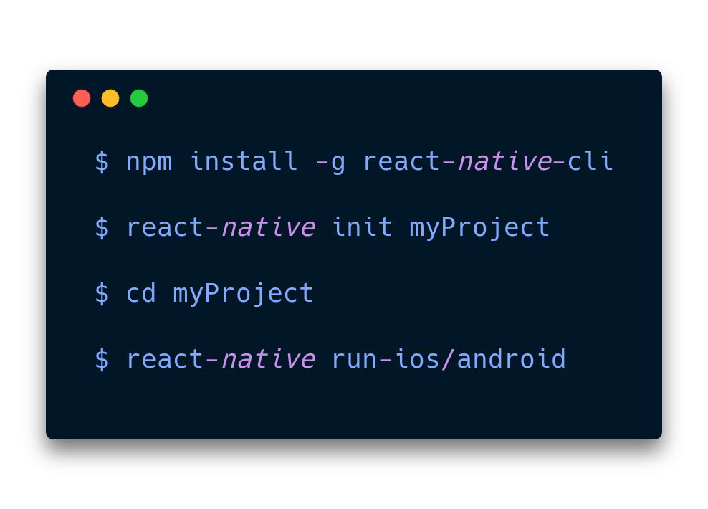

Slide 29
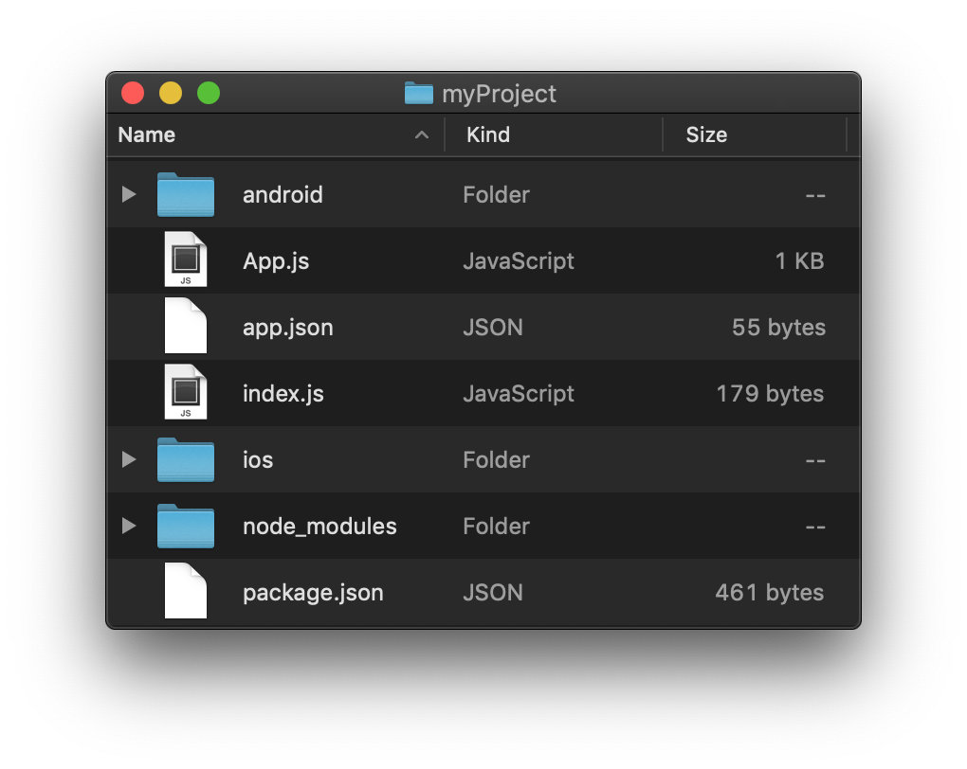

Slide 30
create-react-native-app
Requires NPM/yarn
Does not require Android Studio/Xcode
Runs on device/simulator with Expo app
Does not require internet (except when installing)
Does not contain native project files

Slide 31
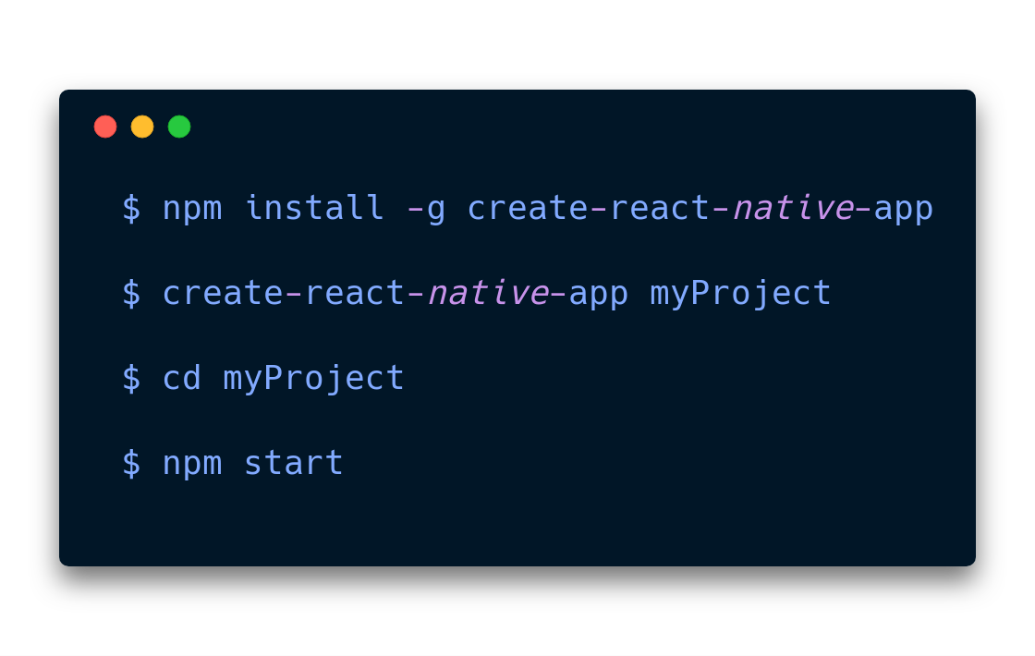

Slide 32
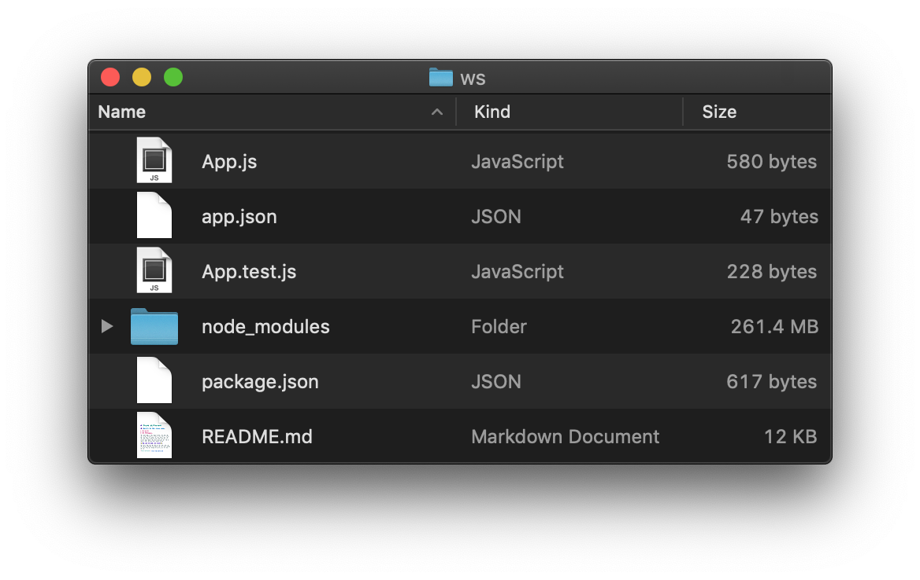

Slide 33
Expo Snack
Web IDE
Runs on device/simulator with Expo App
Requires internet (files are stored online)
Fastest reload time among the 3
http://snack.expo.io

Slide 34
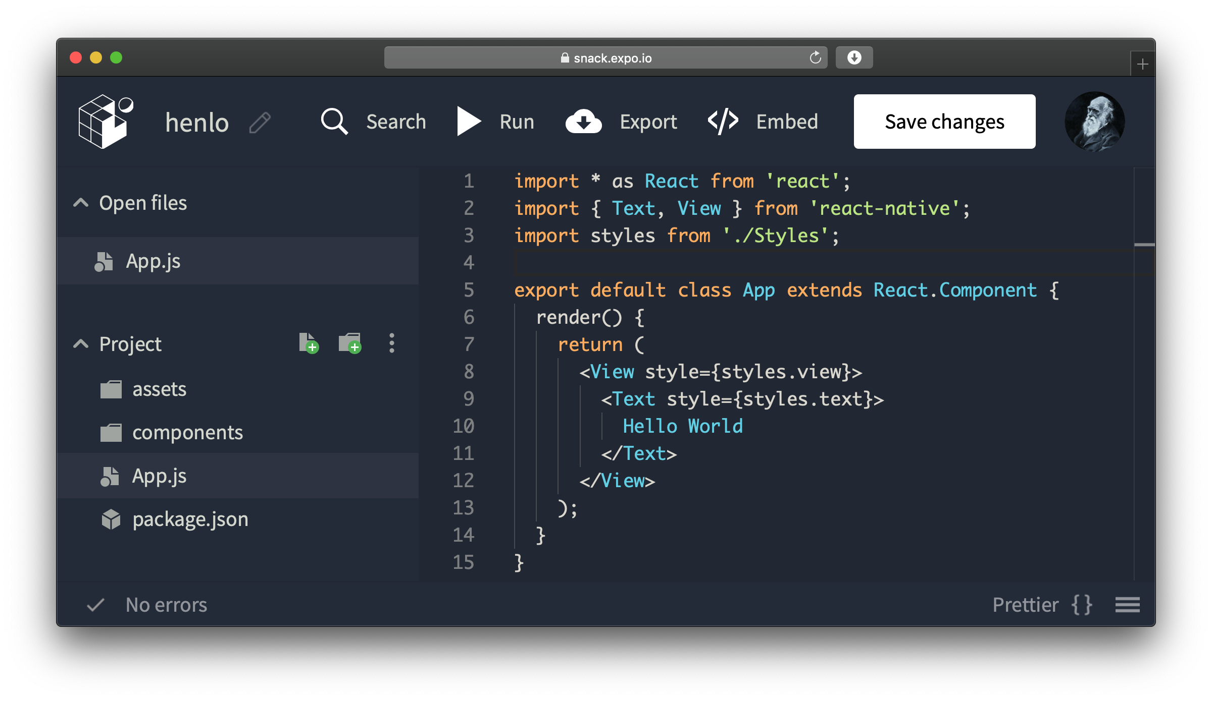
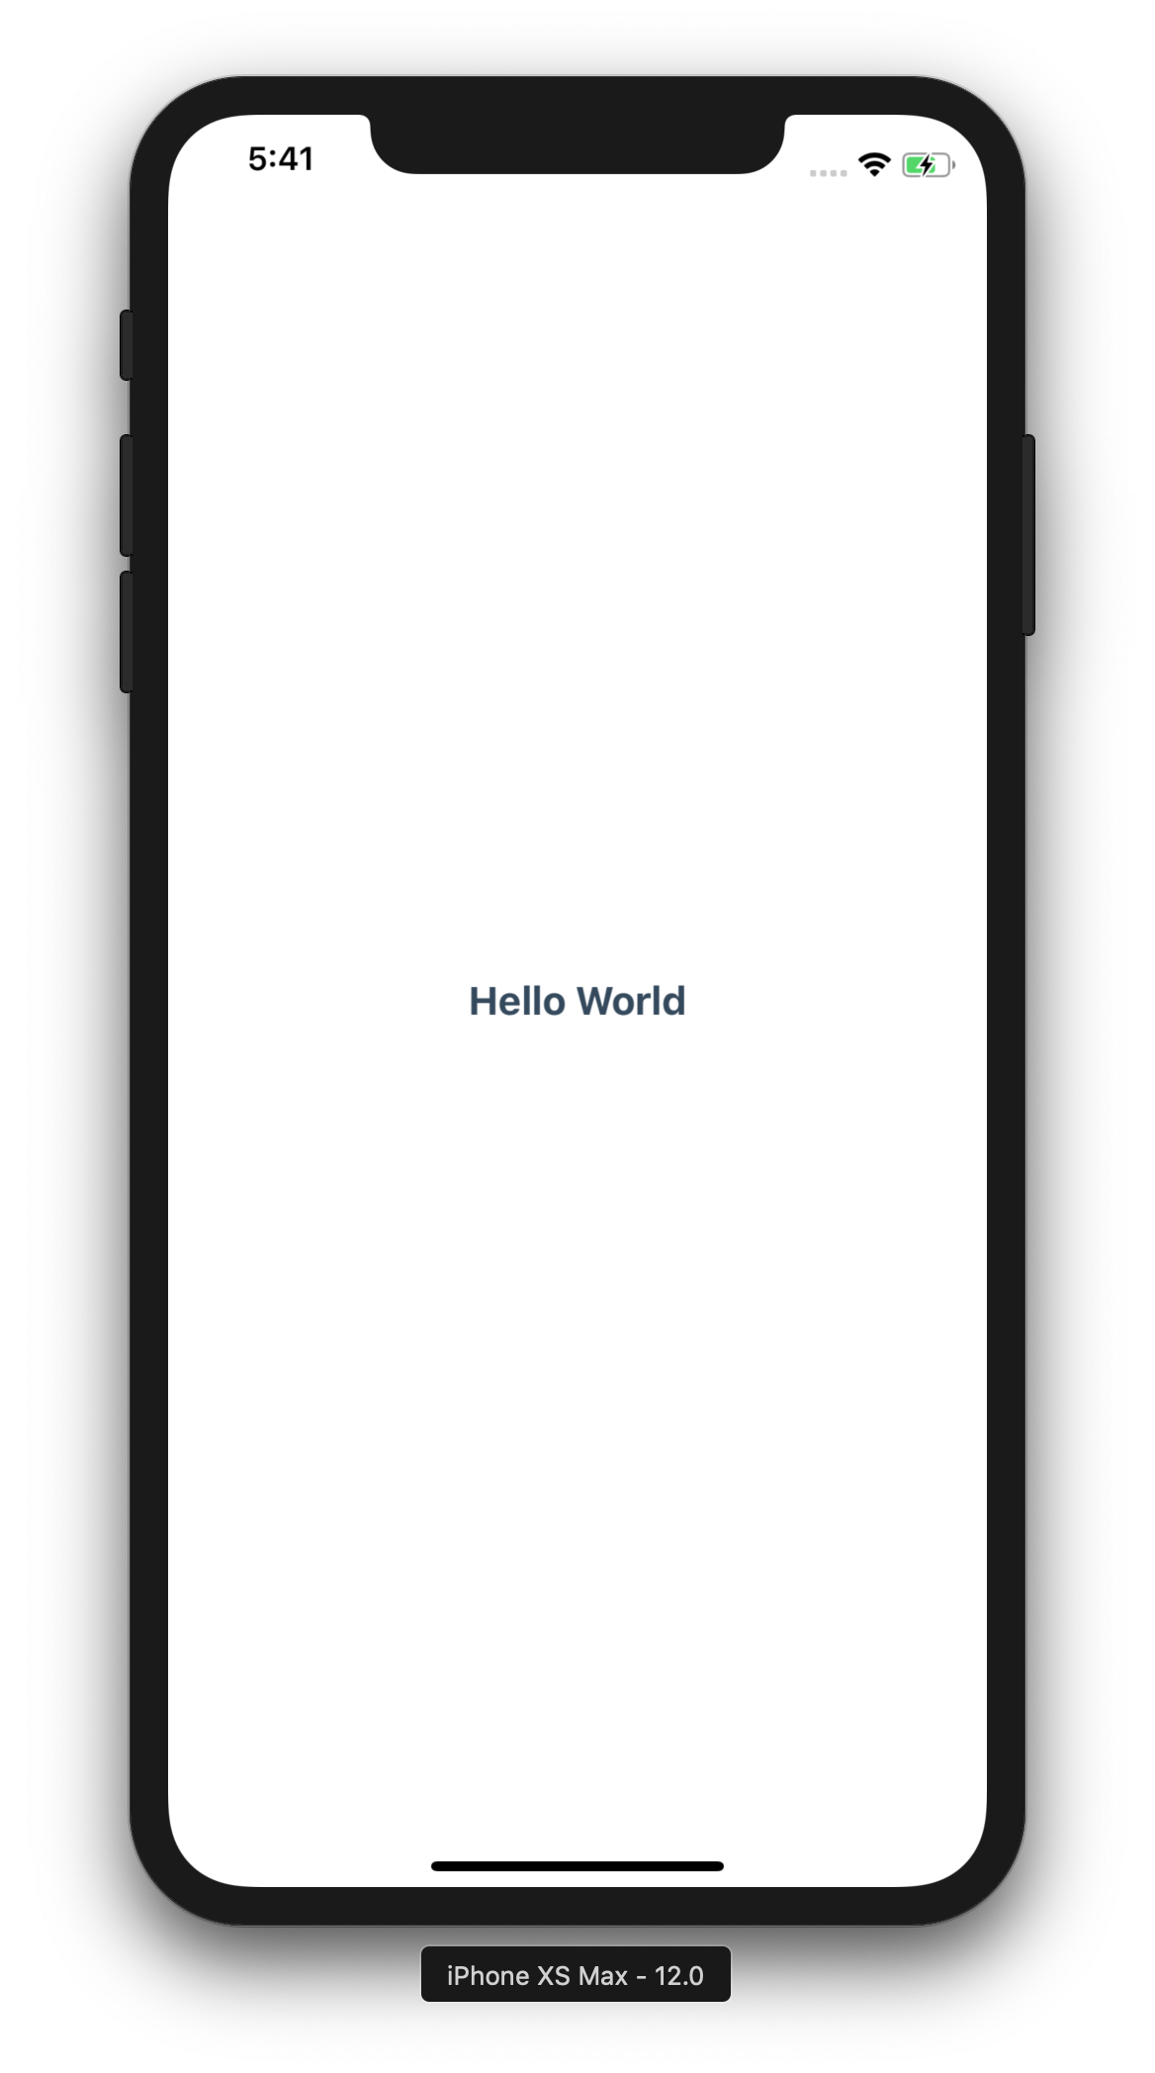
Expo Snack

Slide 35
App Deploy
Expo Snack
create-react-native-app
react-native eject
react-native init

